Slide 1
Star Bakery app
Give your bakery a rising start
Brought to you by: SelectStar

Slide 2
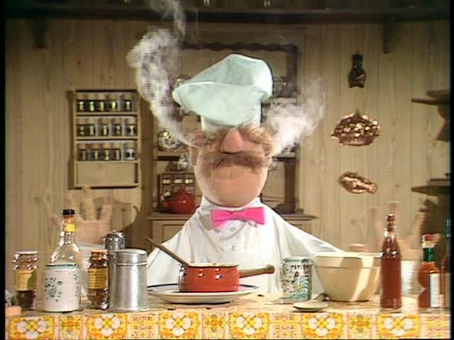

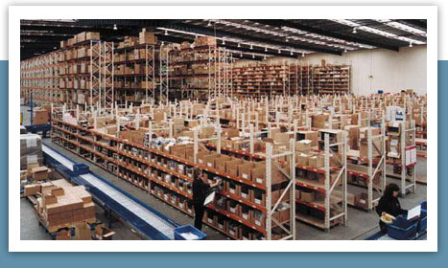

Bakery App Users
Chefs
Procurement Manager
Sales
Business Analyst

Slide 3
IMPORTANT USE CASES
Sales
Create new sales orders or update existing orders
Insert new customer or update customer details
Search existing customers or sales orders with customer Id or order Id
Calculate total sales for a particular time period
Chef
Determine what to bake based on QUANTITY_AVAILABLE of SALES_ORDER_ITEM
Increase number of baked goods available per sales order item
Look at baked good recipe and determine what ingredients are available for this baked good.

Slide 4
IMPORTANT USE CASES
Goods Procurement
Create Purchase Order
Add suppliers to supplier table
Update Supplier Information
Business Analyst
View total historical sales by customer
Change finished product sales prices based on demand
View total sales by product to determine whether to continue or discontinue production of the item
Access using views to ensure data quality

Slide 5
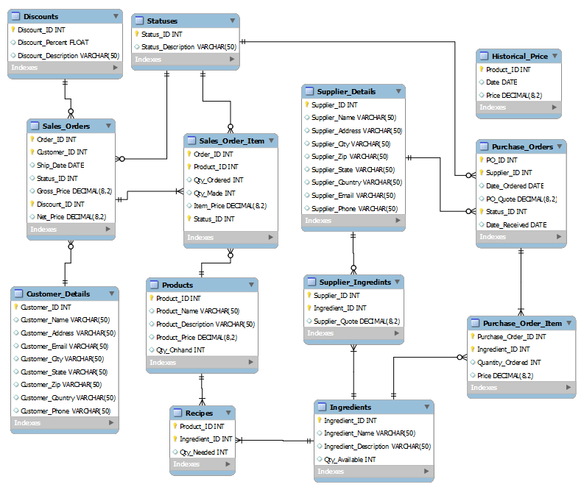

Slide 6
Project Summary
What did you learn from this project?
Better grasp of SQL
How to design a database from scratch
How to better communicate within a team
What problems did you encounter from this project
The initial difficulties in defining the scope of the database
How do you keep an audit trail on a critical table?
Creating realistic test data
How do views apply to our database?

Slide 7
Project summary
How did you solve these problems?
Brainstorming, drawing pictures, and clear communication
We used a trigger table with temporary variables to create an audit trail
Identified real world attributes
Business Analyst role is heavily reliant on views
If you were to do this project again, what methodology would you follow?
Find and understand the scope of the project
Draw diagrams as soon as possible and build from there

Slide 8

Thank you
Questions?

